Slide 1
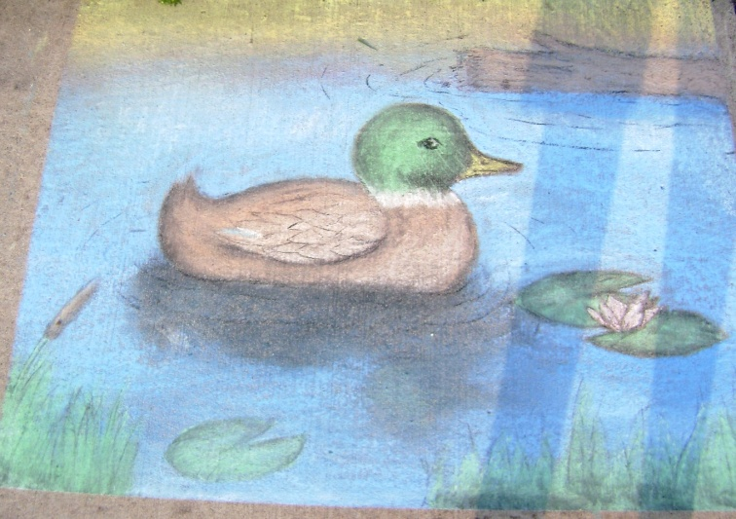
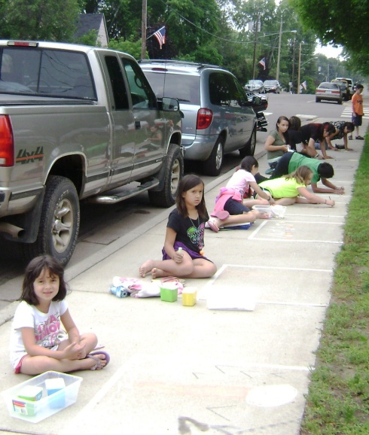
CCC Sidewalk Chalk Art Contest
2015 Theme: Animals Around Us
Categories: grade k-4 *
grade 5-8 *
grade 9-12 *
adult * grade completed
Rules: original art composition
no electronic aides
no personal art supplies
no “adult content”
Categories subject to change based on participation
Art must be completed between 1:00 – 7:00pm Fri.
FREE EVENT
2014 Best of Show: Samantha Bostrom
Chalk, paper towels, & fixative will
be furnished by We’ll Care Hair Care & Massage
Criteria | P | A | G | E
Theme
Center of Interest
Balance
Color
Overall Execution
Sample Score Card
2014: 1st Annual Contest
“Category” & “Best of Show” Prizes
contributed by Explore Art & other local businesses
Pre-registration : www.hinckleychamber.com

